Slide 1
5x5x5 LED Cube
Project By:
John Liang
Kohei Saito
Siva Moole

Slide 2
Table of Contents
LED Cube
Cube Construction
Base Construction
IC Logic
Ohms Law
Code
XBee
Configuration/ Initialization
Sending/Receiving Data
Closing Connection
Frequency Analysis
Representation of sound on a computer and Fast Fourier Transforms
Coding to analysis music

Slide 3
Construction of Cube
A basic list of components:
150 LEDs
1 Perforated PC Board
22 Gauge wire
4 IC LS238 Chips, active High Output
30 NPN transistors (act as switches)
1 Arduino Uno
2 Xbee Series 1
1 Explorer for Xbee
1 Xbee shield for Arduino Uno

Slide 4
Construction of Cube
Test LED’s making sure all are working
The LED’s are connected with horizontal anodes and vertical cathodes.
Each horizontal layer share a common anode
Each vertical column (5 LED’s) share a common cathode.
Within the LED Cube added 22 gauge wire to help stabilize the structure
Setup components on bread board for testing.
Solder the components to the PC board but not the wires from the cube.
Once top of the base is constructed thread the wires through
Solder the wires to the PC board then finish constructing base.

Slide 5
Base Construction
4 pieces of 10” x 6” x 1” wood cut at 45° angle
1 piece of 7 ¾” x 7 ¾” x ¼” wood
1 piece of 8”x8” x ¾” wood
1 Can of rubberized spray paint

Slide 6
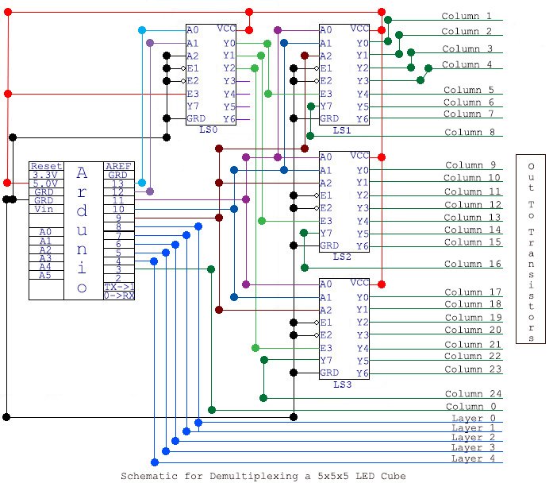
PC Board Schematic

Slide 7
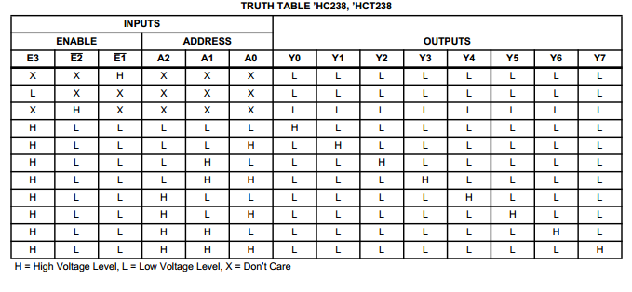
LS238 Logic

Slide 8
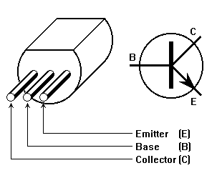
Transistor Logic

Slide 9

Ohms Law
Ohm’s Law is I = $\frac{V}{R}$
A Transposition of Ohm’s Law calculating for resistance is
$R= \frac{V}{I}$
Resistance was calculated for 1 LED even though there are 5 LED’s
The LED’s are rated for 20mA or 0.02Amps (The current)
$R= \frac{5Volts}{0.02Amps}$ = 250Ohm Resistance per column

Slide 10
The Code
Must use the truth table from the LS238 chip
First LS238 chip’s output is determined by Pins 12, and 13 from the Arduino
Not using Pin Yo output to enable others, Using Pin for clear() method.
The LedOn(int led) method
Turns the Led on for 1ms.
Method of calculating corresponding column number for LED
If the LED number is less than or equal to 25 just return the LED number
If LED number is greater than 25
Minus one from LED number and take the mod 25
Method of calculating the corresponding row
If LED number is less than or equal to 25 return layer zero
If LED number is greater than 25, return LED number divided by 25.

Slide 11
Xbee Configuration
Configuration
Using 16 bit addressing for use of MYID for Xbee
Meaning we can ignore the 64 bit addressing of Serial High, Serial Low
Using MAC MODE 0
MAC mode for 802.15.4 MAXSTREAM Header with ACK's
MAXSTREAM is for modem capability
Attempted use of no ACKS showed visible dropped packets
Using PAN ID of 8888
Using API Mode with PPP
Provides three types of protocols
Link Connection
Authentication
Network

Slide 12
Xbee Sending/Receiving
Xbee Sender
Set the 16 bit MYID to 1
Sending one LED number at a time creates indiscernible patterns in lighting
The sender must fill the 100 bytes of available memory space inside packet
The 100 bytes of payload holds 50 integers or LED numbers
The packet is sent even if all 5o slots of the LED array is not full if cycle ends
A cycle is the processing of one sample of music. (Kohei will explain further)
Xbee Reciever
MYID set to 2
The Xbee receiver iterates through the payload array and calls the function of
LedOn(int LED) and loops forever. (or at least till there is no power).

Slide 13
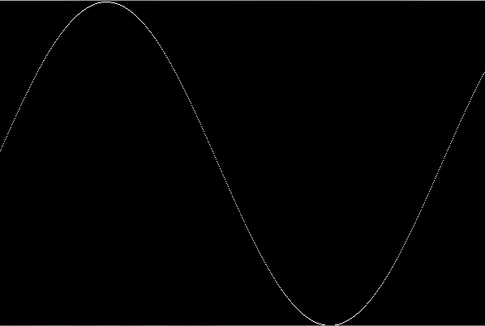
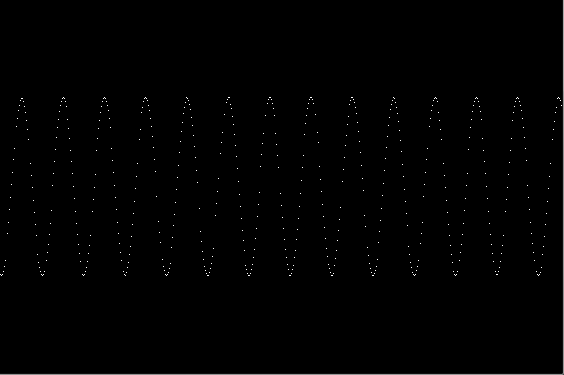
Principle of the Sound
The principle of the sound is the “vibration” and we recognize sound by recognizing the vibration.
The “vibration” can be represented as the wave.
All sound have the volume, pitch, and frequency.
80Hz 1000Hz

Slide 14

FFT Algorithm
FFT algorithm (Faster Fourier Transform) is the way to analyze the frequency.
It transforms signal in time domain (Sample Rate) into a signal in frequency domain.
In this algorithm it is impossible to calculate individual frequencies but calculate the frequencies of certain range.

Slide 15
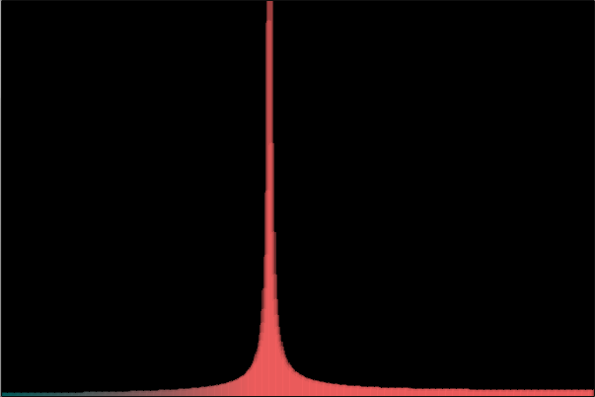

FFT Algorithm
Frequency at 1000Hz
Songs

Slide 16
Sound API
Minim library is the Sound API for processing dealing with mp3, wav or other various file formats.
Basic Function (ddf.minim.*)
AudioFile loadFile(String filename, int bufferSize)
void play()
void close() , void stop()
FFT Function (ddf.minim.analyze.*)
abstract void forward(AudioBuffer buffer)
int specSize()
float getBandWidth(int i)
float getBand(int i)

Slide 17
Variables for FFT
Sampling Rate -> 44100Hz
Default value of mp3
BufferSize -> 1024
Default value for mp3
SpecSize -> BufferSize / 2 = 512
Size will be half of buffer size due to FFT algorithm
BandWidth -> Sampling Rate/ BufferSize = 43.066406Hz
Each block have the range of about 43Hz
ex)
Block 0: 0.0Hz ~ 43.066406Hz
Block 1: 43.066406Hz ~ 86.13281Hz
Block 2: 86.13281Hz ~ 129.19922Hz

Slide 18
Divide Frequency into Low, Mid, High
Each frequency range have 4 setting variable.
Low Frequency
lowStart: starting point of low frequency
lowEnd: ending point of low frequency
lowVol: volume filter for low frequency
bplLow: blocks/LED for low frequency
Same variables for MID and HIGH
ex) midStart, highStart

Slide 19
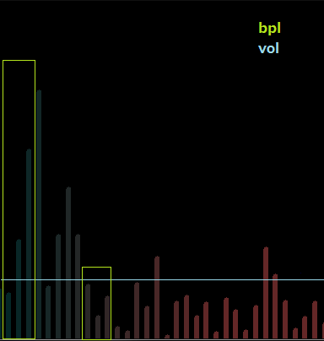
Programming
int n = number of block
If: Start <= n <= End
for: int i; i >= bpl; i++
if: frequency volume > vol
return true
else
return false
Each line represent each band(block: 43.066406Hz)

Slide 20
Example
AND HERE IS THE CUBE BEING DRIVEN BY MUSIC.

